Slide 1



Business_Insights_360
View in Power BI
Last data refresh:
20/03/2024 09:43:56 UTC
Downloaded at:
20/03/2024 09:47:01 UTC

Slide 2
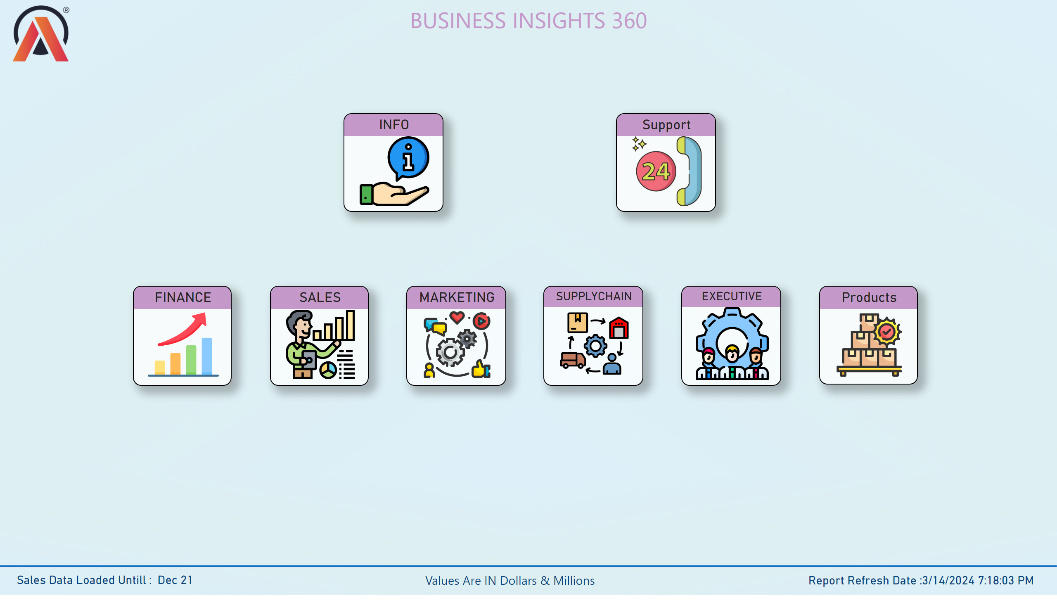
HOME
Notes:
SALES
No alt text provided
SUPPLYCHAIN
No alt text provided
Support
No alt text provided
FINANCE
No alt text provided
MARKETING
No alt text provided
EXECUTIVE
No alt text provided
INFO
No alt text provided
textbox
No alt text provided
image
No alt text provided
shape
No alt text provided
card
No alt text provided
textbox
No alt text provided
card
No alt text provided
Products
No alt text provided

Slide 3
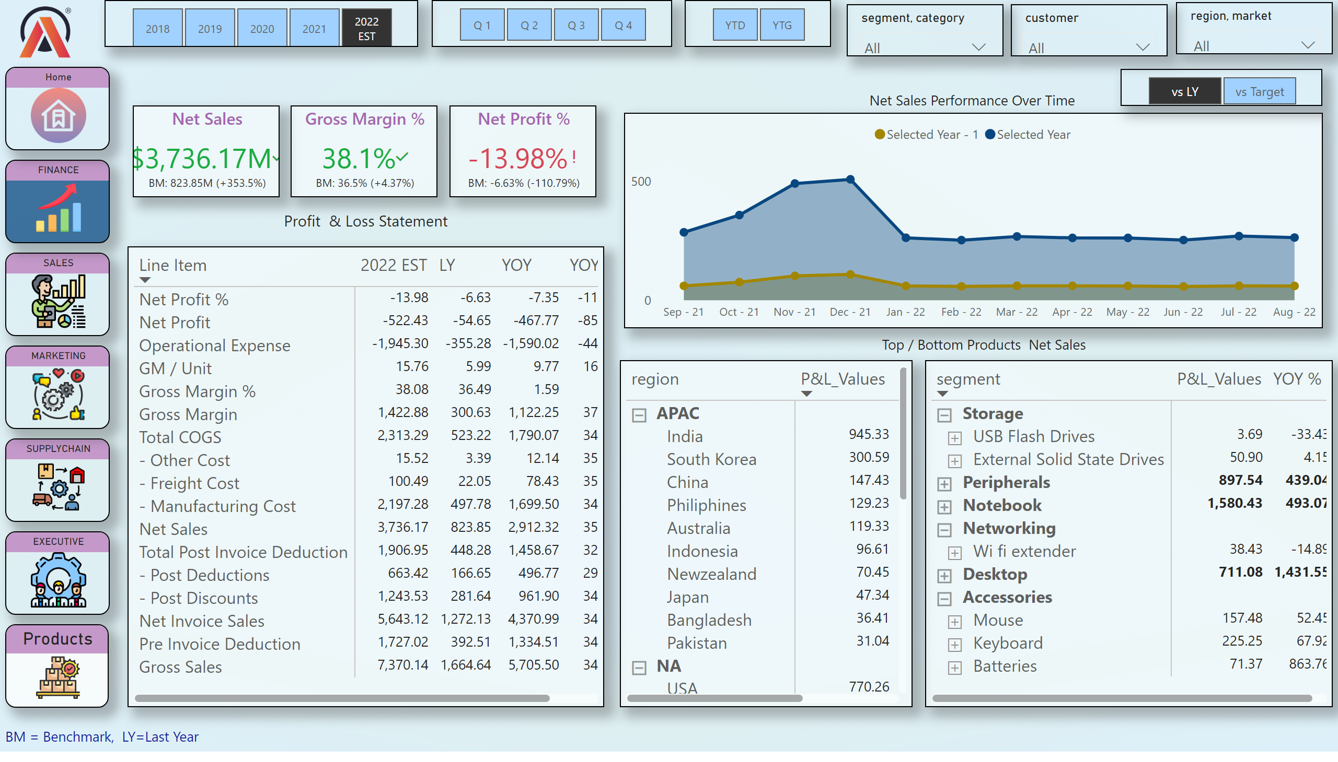
Finance_View
Notes:
pivotTable
No alt text provided
slicer
No alt text provided
slicer
No alt text provided
slicer
No alt text provided
Net Sales Performance Over Time
No alt text provided
pivotTable
No alt text provided
pivotTable
No alt text provided
image
No alt text provided
SALES
No alt text provided
SUPPLYCHAIN
No alt text provided
MARKETING
No alt text provided
FINANCE
No alt text provided
EXECUTIVE
No alt text provided
Home
No alt text provided
card
No alt text provided
card
No alt text provided
textbox
No alt text provided
slicer
No alt text provided
slicer
No alt text provided
slicer
No alt text provided
Net Sales
No alt text provided
Gross Margin %
No alt text provided
Net Profit %
No alt text provided
textbox
No alt text provided
slicer
No alt text provided
card
No alt text provided
Products
No alt text provided

Slide 4
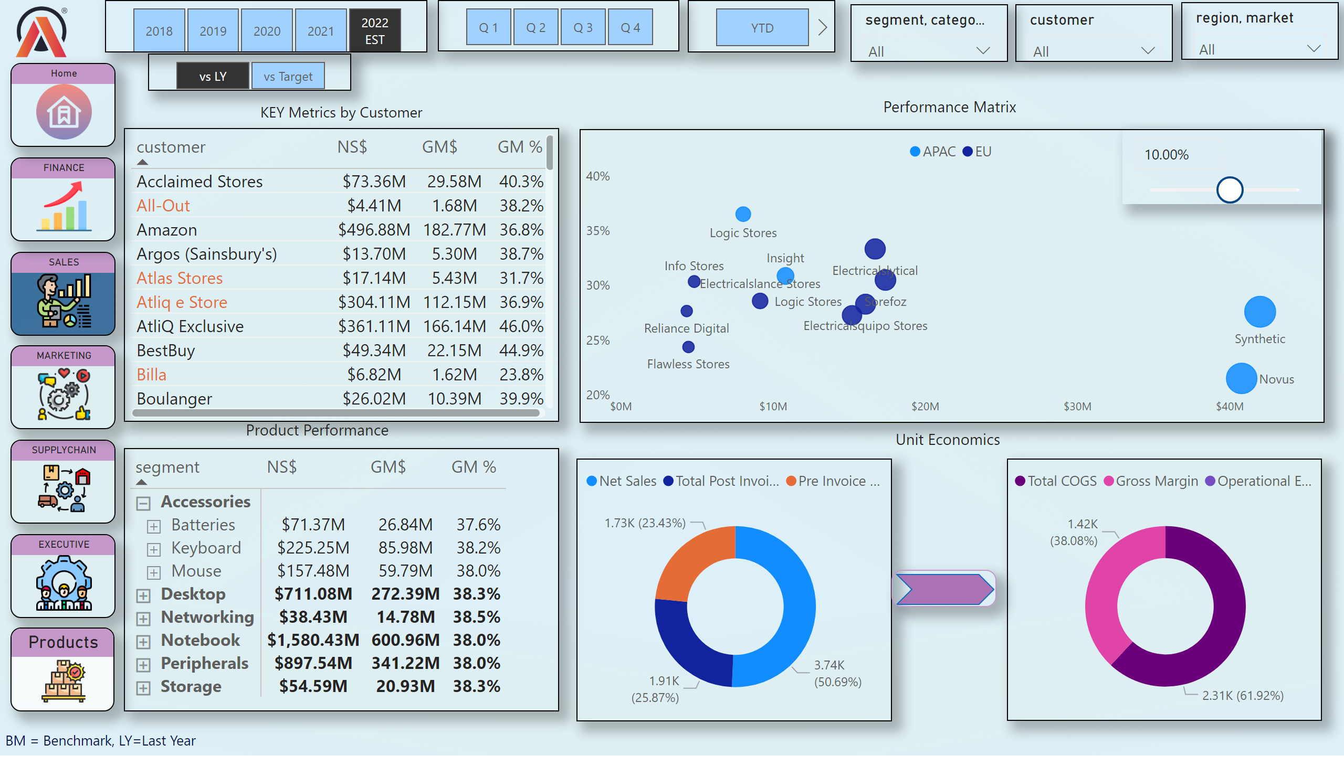
Sales_View
Notes:
tableEx
No alt text provided
scatterChart
No alt text provided
pivotTable
No alt text provided
donutChart
No alt text provided
donutChart
No alt text provided
shape
No alt text provided
slicer
No alt text provided
slicer
No alt text provided
slicer
No alt text provided
slicer
No alt text provided
slicer
No alt text provided
slicer
No alt text provided
image
No alt text provided
SALES
No alt text provided
SUPPLYCHAIN
No alt text provided
MARKETING
No alt text provided
FINANCE
No alt text provided
EXECUTIVE
No alt text provided
Home
No alt text provided
textbox
No alt text provided
textbox
No alt text provided
textbox
No alt text provided
textbox
No alt text provided
textbox
No alt text provided
slicer
No alt text provided
slicer
No alt text provided
Products
No alt text provided

Slide 5
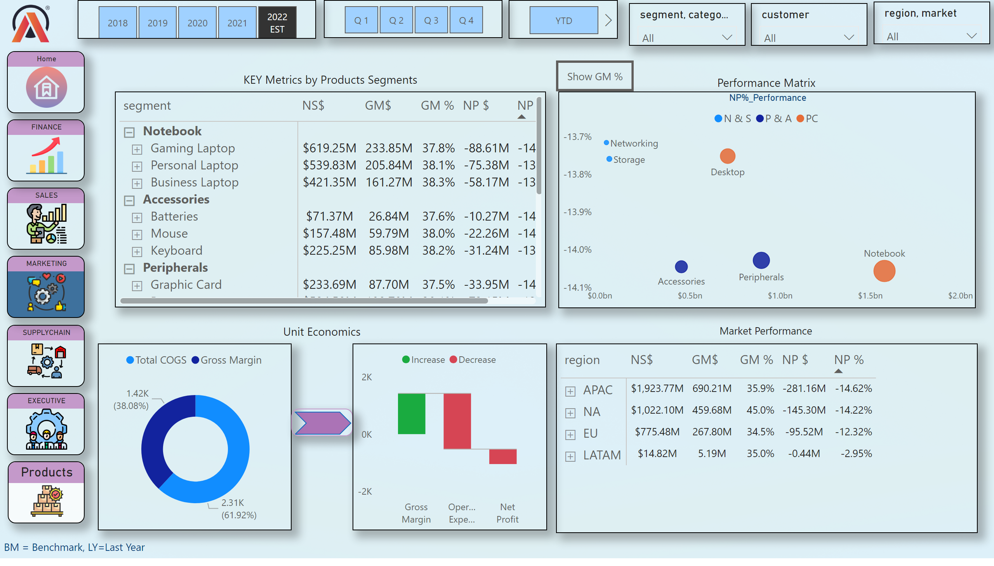
Marketing_View
Notes:
scatterChart
No alt text provided
pivotTable
No alt text provided
donutChart
No alt text provided
shape
No alt text provided
waterfallChart
No alt text provided
pivotTable
No alt text provided
slicer
No alt text provided
slicer
No alt text provided
slicer
No alt text provided
slicer
No alt text provided
slicer
No alt text provided
slicer
No alt text provided
image
No alt text provided
SALES
No alt text provided
SUPPLYCHAIN
No alt text provided
MARKETING
No alt text provided
FINANCE
No alt text provided
EXECUTIVE
No alt text provided
Home
No alt text provided
textbox
No alt text provided
textbox
No alt text provided
textbox
No alt text provided
textbox
No alt text provided
textbox
No alt text provided
GM%Button
No alt text provided
actionButton
No alt text provided
NP%_Performance
No alt text provided
Products
No alt text provided

Slide 6
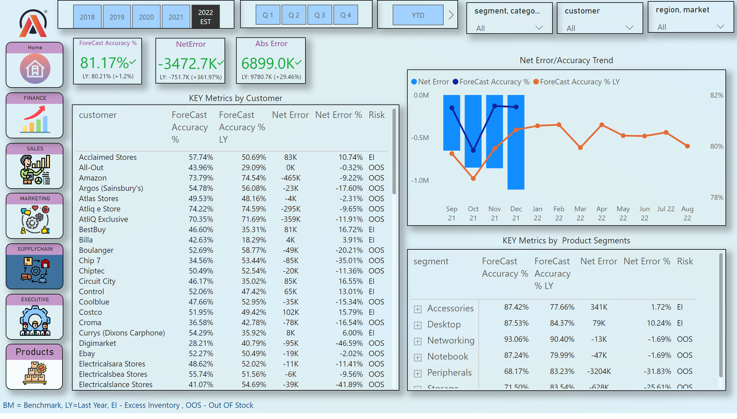
SupplyChain_View
Notes:
pivotTable
No alt text provided
NetError
No alt text provided
ForeCast Accuracy %
No alt text provided
Abs Error
No alt text provided
tableEx
No alt text provided
lineClusteredColumnComboChart
No alt text provided
image
No alt text provided
SALES
No alt text provided
SUPPLYCHAIN
No alt text provided
MARKETING
No alt text provided
FINANCE
No alt text provided
EXECUTIVE
No alt text provided
Home
No alt text provided
slicer
No alt text provided
slicer
No alt text provided
slicer
No alt text provided
slicer
No alt text provided
slicer
No alt text provided
slicer
No alt text provided
textbox
No alt text provided
textbox
No alt text provided
textbox
No alt text provided
textbox
No alt text provided
Products
No alt text provided

Slide 7
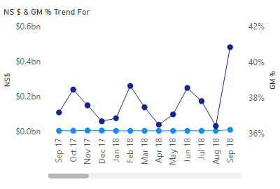
sales_tooltip
Notes:
NS $ & GM % Trend For
No alt text provided

Slide 8
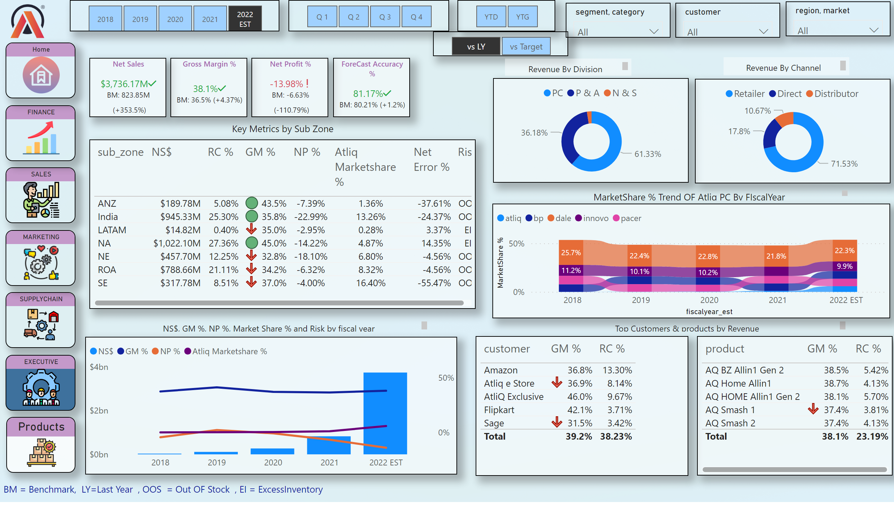
Executive_View
Notes:
tableEx
No alt text provided
slicer
No alt text provided
slicer
No alt text provided
slicer
No alt text provided
Net Sales Performance Over Time
No alt text provided
tableEx
No alt text provided
tableEx
No alt text provided
image
No alt text provided
SALES
No alt text provided
SUPPLYCHAIN
No alt text provided
MARKETING
No alt text provided
FINANCE
No alt text provided
EXECUTIVE
No alt text provided
Home
No alt text provided
textbox
No alt text provided
slicer
No alt text provided
slicer
No alt text provided
slicer
No alt text provided
Net Sales
No alt text provided
Gross Margin %
No alt text provided
Net Profit %
No alt text provided
textbox
No alt text provided
slicer
No alt text provided
card
No alt text provided
ForeCast Accuracy %
No alt text provided
Net Sales Performance Over Time
No alt text provided
textbox
No alt text provided
textbox
No alt text provided
lineClusteredColumnComboChart
No alt text provided
textbox
No alt text provided
textbox
No alt text provided
ribbonChart
No alt text provided
textbox
No alt text provided
Products
No alt text provided

Slide 9
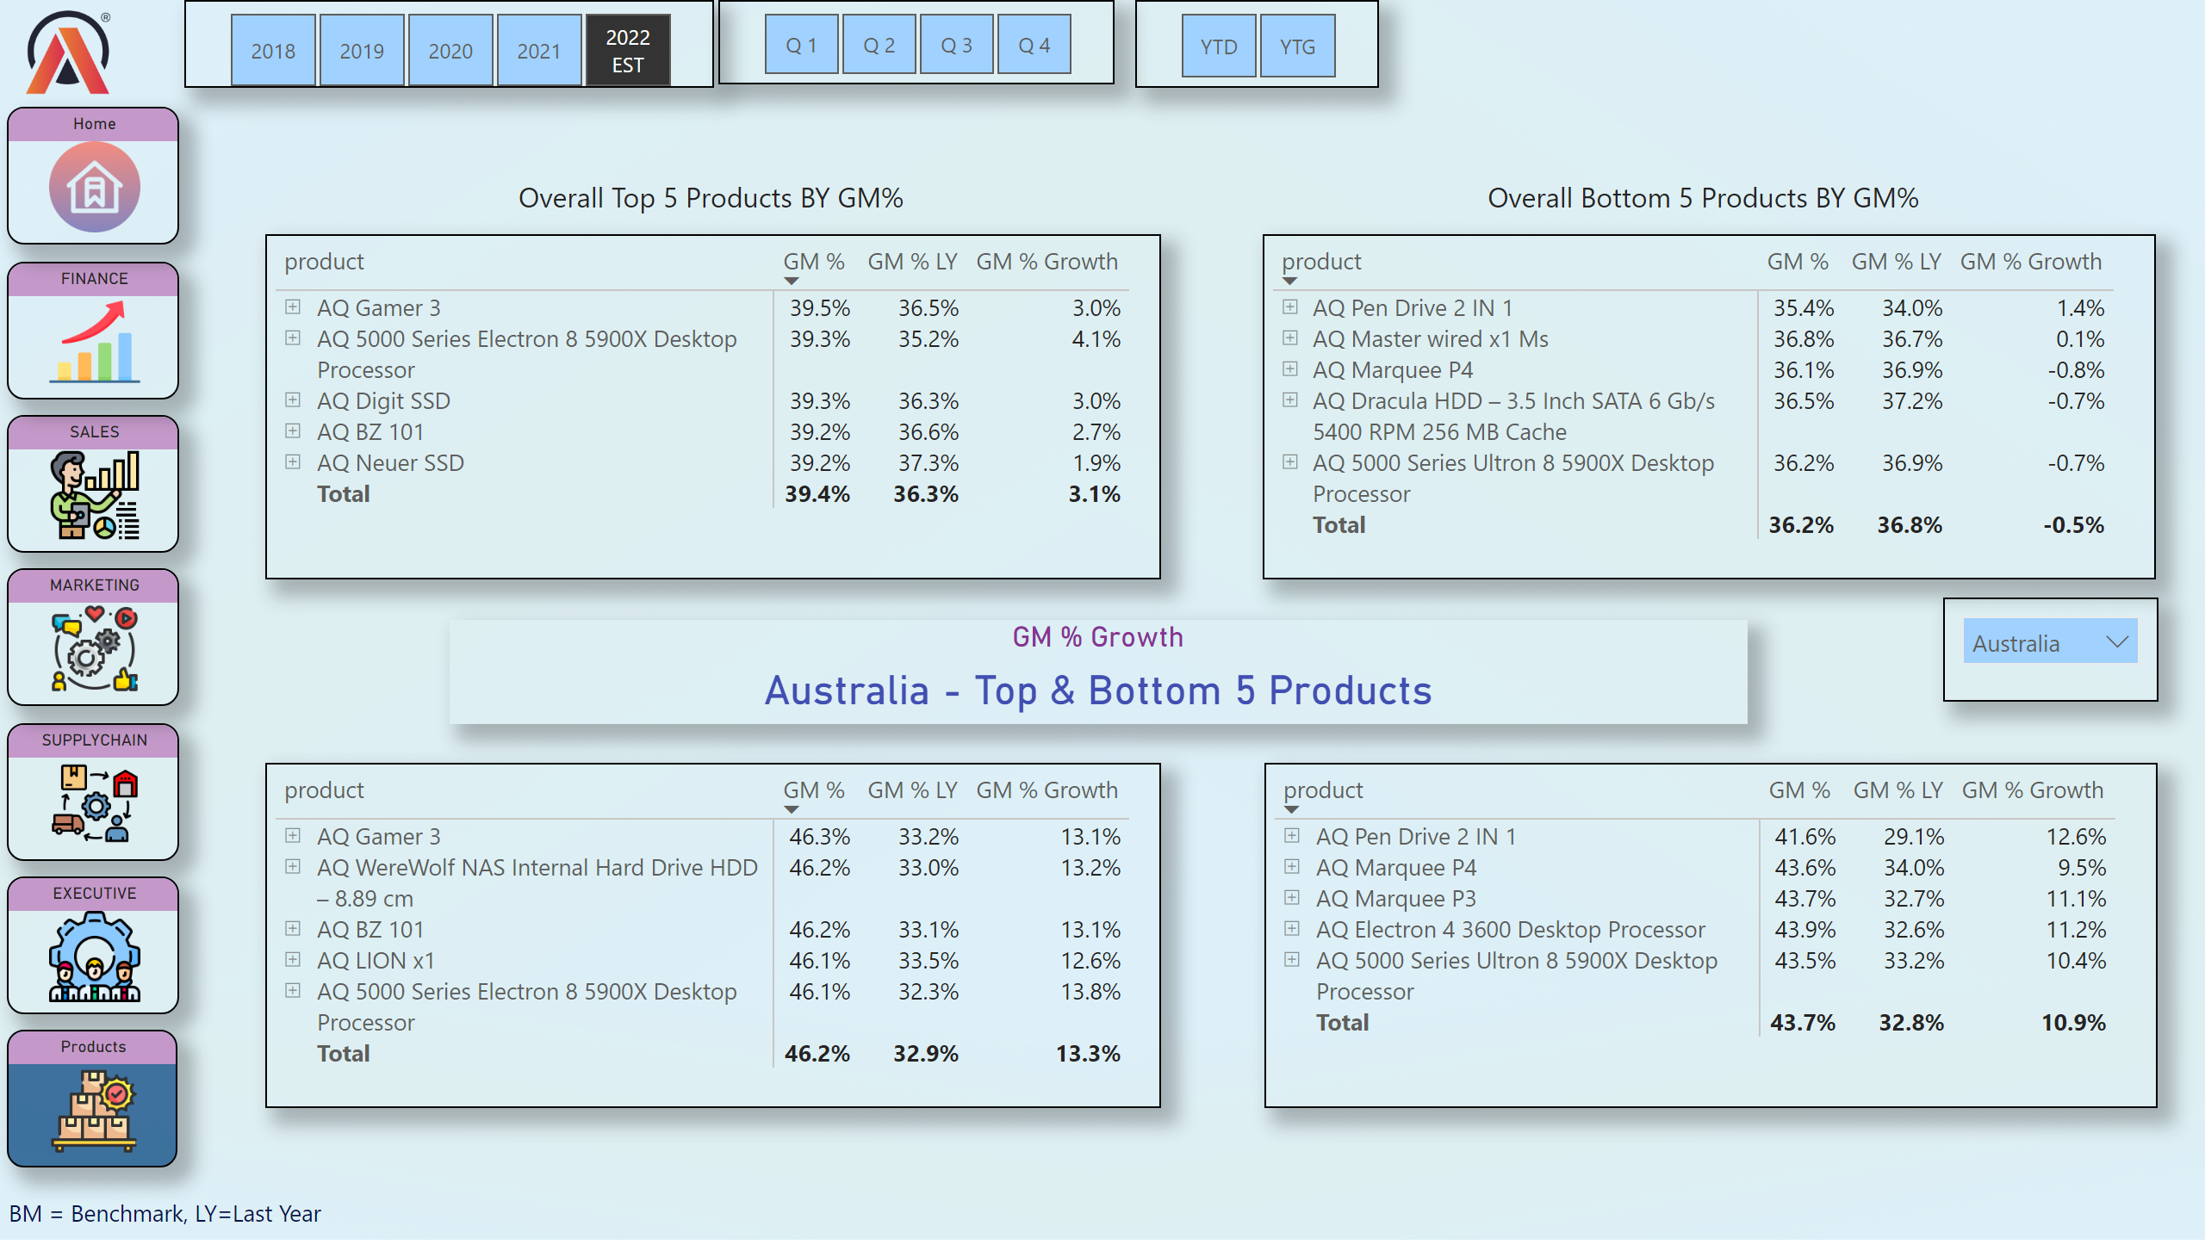
products
Notes:
slicer
No alt text provided
slicer
No alt text provided
slicer
No alt text provided
image
No alt text provided
SALES
No alt text provided
SUPPLYCHAIN
No alt text provided
MARKETING
No alt text provided
FINANCE
No alt text provided
EXECUTIVE
No alt text provided
Home
No alt text provided
textbox
No alt text provided
pivotTable
No alt text provided
slicer
No alt text provided
pivotTable
No alt text provided
textbox
No alt text provided
textbox
No alt text provided
GM % Growth
No alt text provided
pivotTable
No alt text provided
pivotTable
No alt text provided
Products
No alt text provided

Slide 10
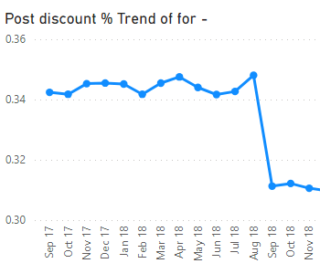
Post_Discount Trend
Notes:
Post discount % Trend of for -
No alt text provided

Slide 11
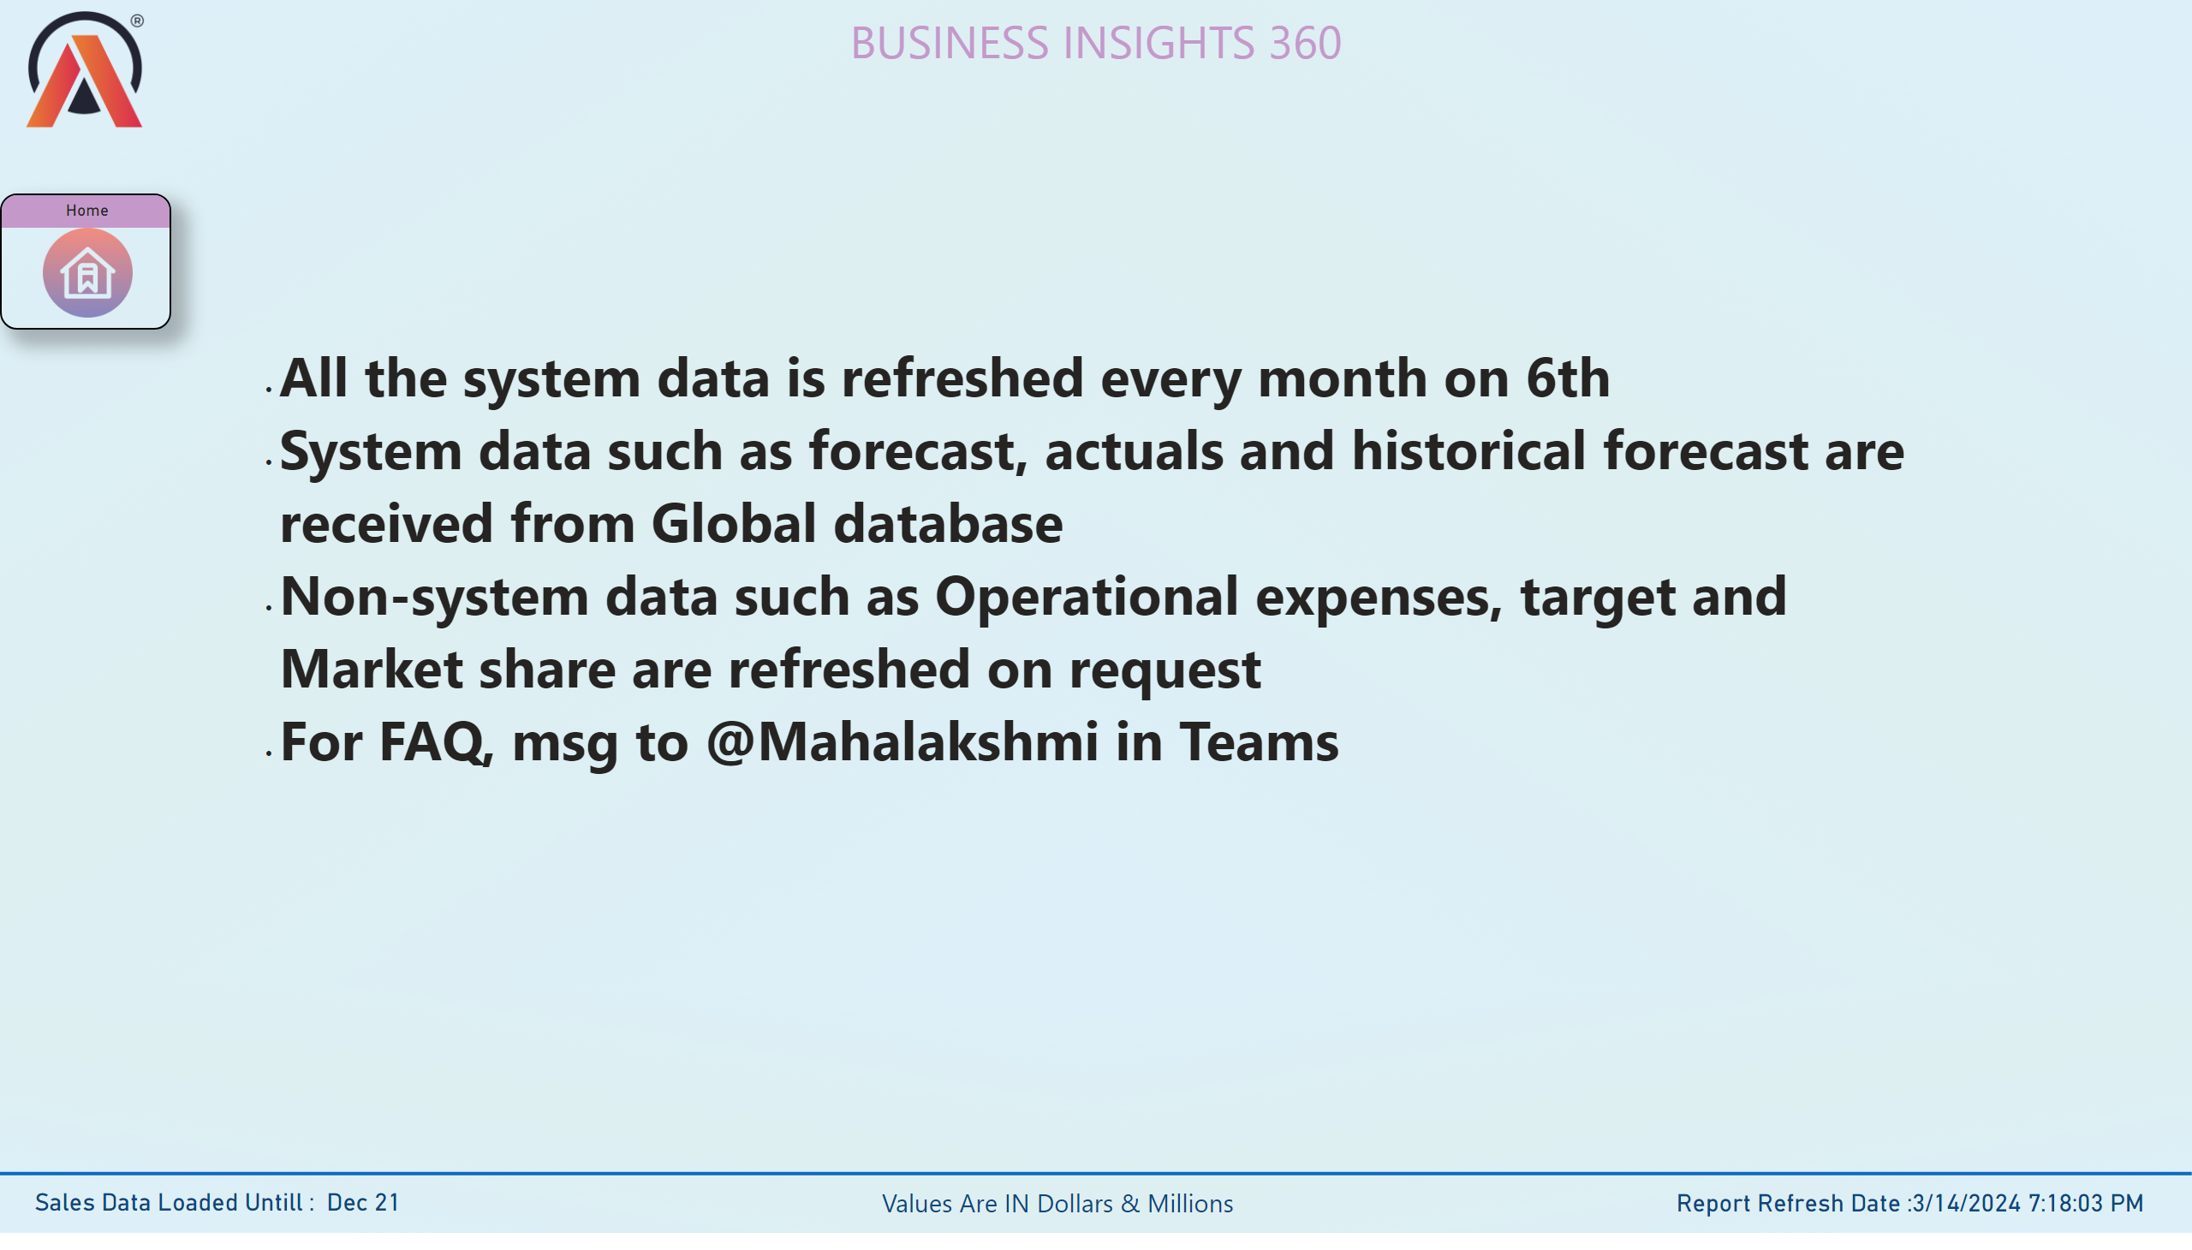
info
Notes:
textbox
No alt text provided
image
No alt text provided
shape
No alt text provided
card
No alt text provided
textbox
No alt text provided
card
No alt text provided
Home
No alt text provided
textbox
No alt text provided

Slide 12
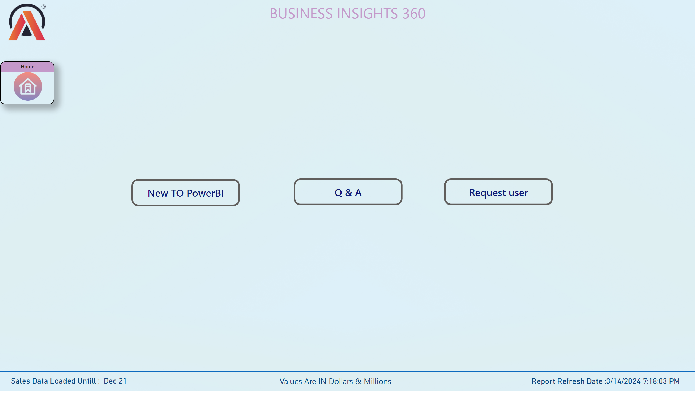
Support
Notes:
textbox
No alt text provided
image
No alt text provided
shape
No alt text provided
card
No alt text provided
textbox
No alt text provided
card
No alt text provided
Home
No alt text provided
actionButton
No alt text provided
actionButton
No alt text provided
actionButton
No alt text provided

